Slide 1
EE4204 Socket Programming Assignment and Example Programs
Prepared by: Sivaraman Vignesh (Ex-Graduate Assistant)
Module Lecturer: Assoc. Prof. Mohan Gurusamy
Electrical and Computer Engineering Department
National University of Singapore

Slide 2
What is socket?
Used to do communication between two processes running on two different machines
An object (special file) which acts as an end point between two machines
Request
P
O
R
T
P
O
R
T
IP Address
IP
Address
Client
Server
Response
Socket | IP_Address:Port (Ex: 127.0.0.1:4950)

Slide 3
Sockets
Application Programming Interface (API)
Interface between an application and network
Application creates a socket
The interface defines the following operations
Create a socket
Attach a socket to the network
Send/receive messages through a socket
Close a socket

Slide 4
Example 1
Develop a socket program in UNIX/Linux that uses (i) TCP as the transport protocol and (ii) UDP as the transport protocol for transferring a short message between a client and server. The client sends a string (input by the user) to the server and the server prints the string on the screen after receiving it.

Slide 5
UDP (Connectionless)
Server
client
Create socket
Bind
ReceiveFrom
Create socket
SendTo

Slide 6
UDP
Socket()
bind()
recv()
close socket
Socket()
send()
close socket

Slide 7
UDP (Connectionless)
Server
client
Create socket
Bind
ReceiveFrom
Create socket
SendTo

Slide 8
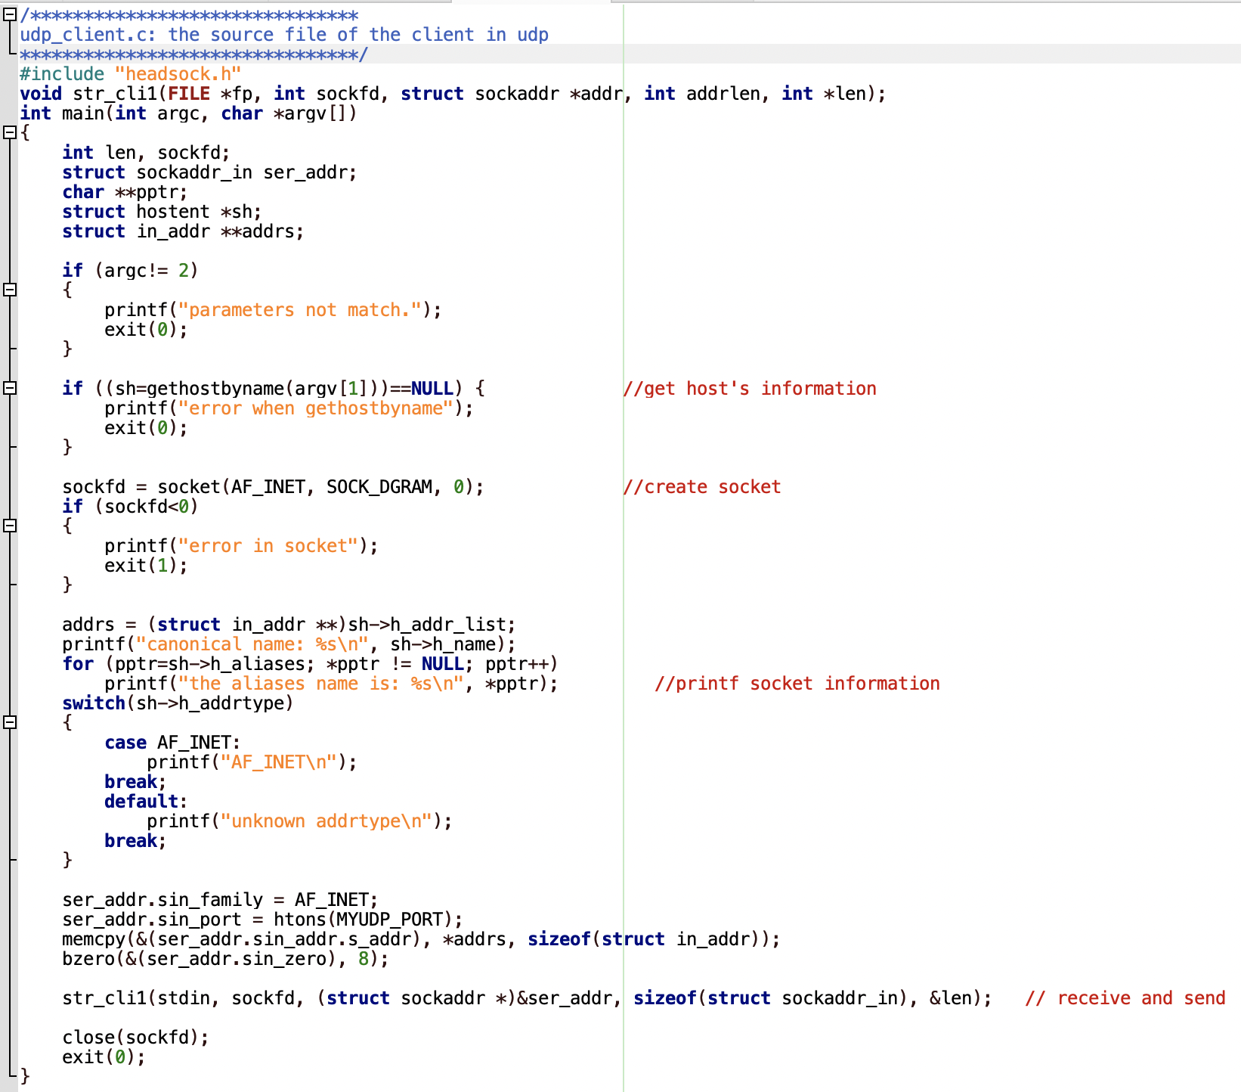
Client

Slide 9
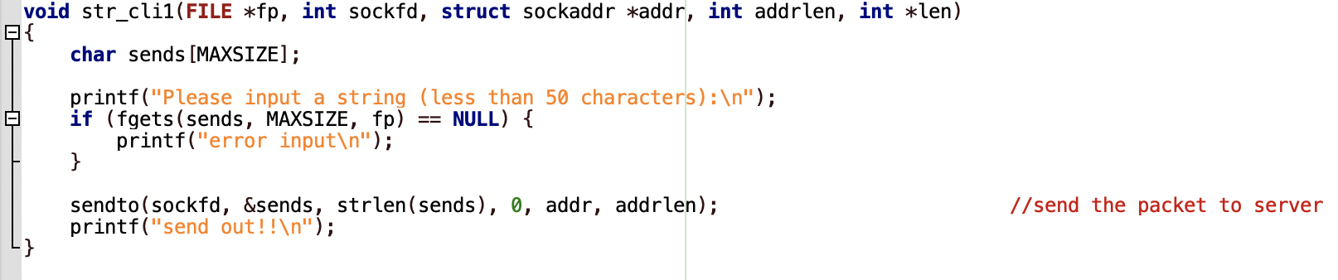
Client
(conti:)

Slide 10
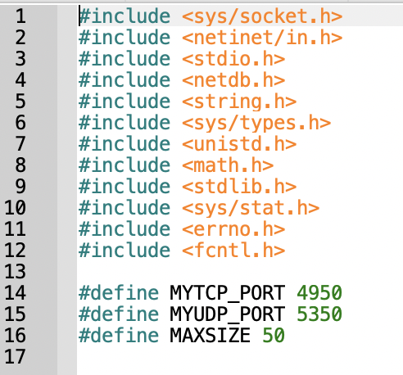
Header file

Slide 11
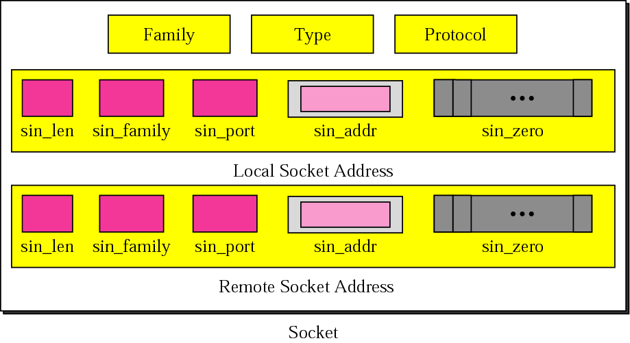
Socket structure
© The McGraw-Hill Companies, Inc., 2000

Slide 12
Socket – Family and Type
Socket Family
AF_INET : Internet Family
AF_UNIX: Unix Pipe facility
Socket Type
SOCK_STREAM: byte stream such as TCP
SOCK_DGRAM: message oriented service such as UDP
Protocol
Specifies either TCP or UDP
‘Zero’

Slide 13
UDP Client
Create a socket
Chosen by the system
© The McGraw-Hill Companies, Inc., 2000

Slide 14
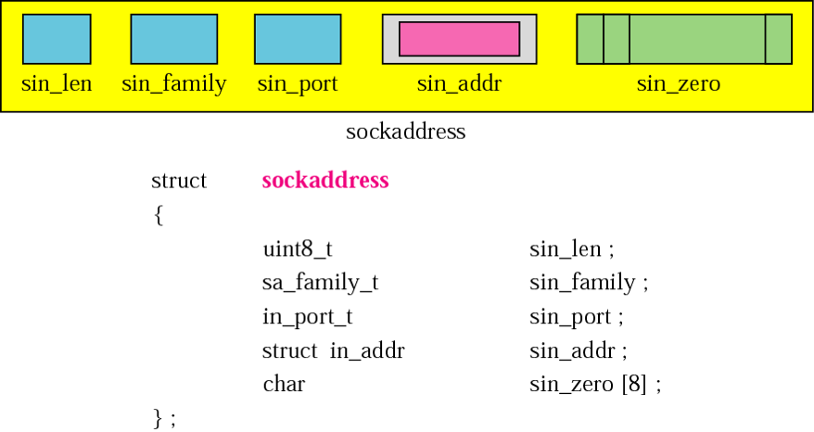
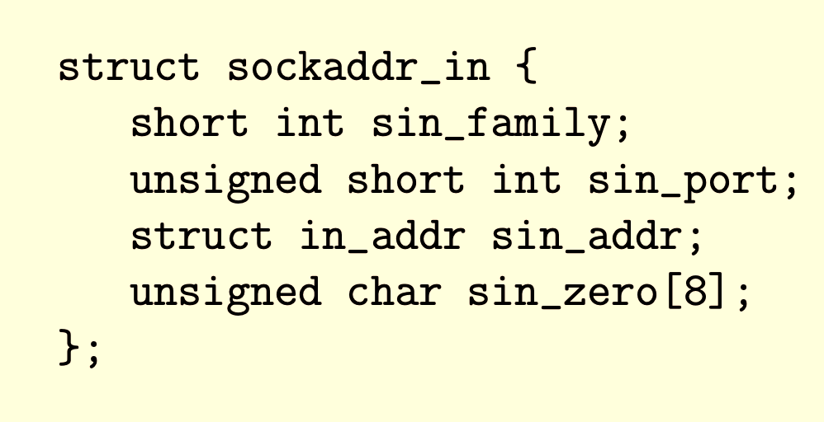
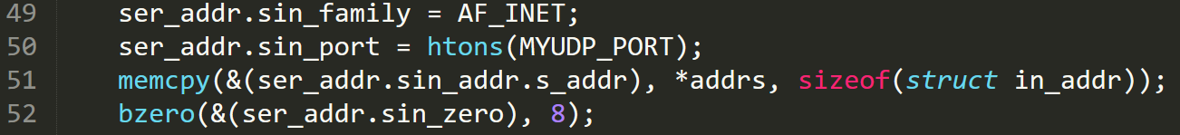
UDP Client
© The McGraw-Hill Companies, Inc., 2000
Get the server address
Has information like name,
aliases, address type etc
Send data to the server
Server address(remote socket)

Slide 15
UDP
Server
client
Create socket
Bind
Receivefrom
Create socket
Sendto

Slide 16
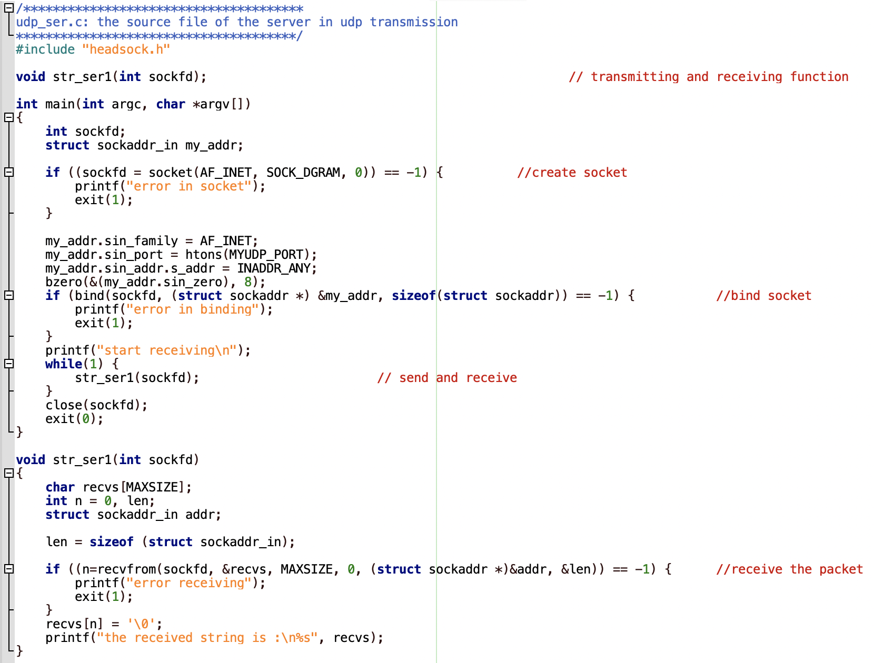

Slide 17
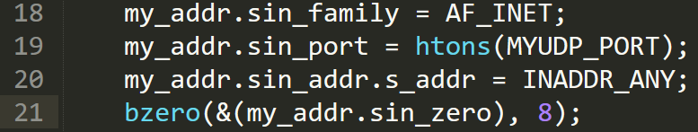
UDP Server
Creating socket is same as the client
Values of the other tuples
In case the system has multiple IPs
© The McGraw-Hill Companies, Inc., 2000

Slide 18
UDP Server
Bind function: Associates the socket with the given local address
Receive from client
Client address (remote socket)
Close the socket (both at server and client)

Slide 19
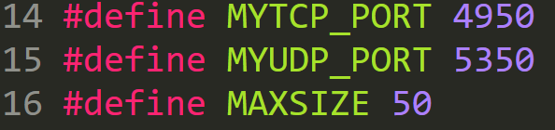
headsock.h (Ex 1)

Slide 20
TCP (Connection-oriented)
server
client
Create socket
Bind
Listen
Accept
Receive/Send
Create socket
Connect
Send/Receive

Slide 21
TCP
Socket()
bind()
accept()
listen()
recv() & send()
close socket
Socket()
connect()
send() & recv()
close socket

Slide 22
TCP
server
client
Create socket
Bind
Listen
Accept
Receive
Create socket
Connect
Send

Slide 23
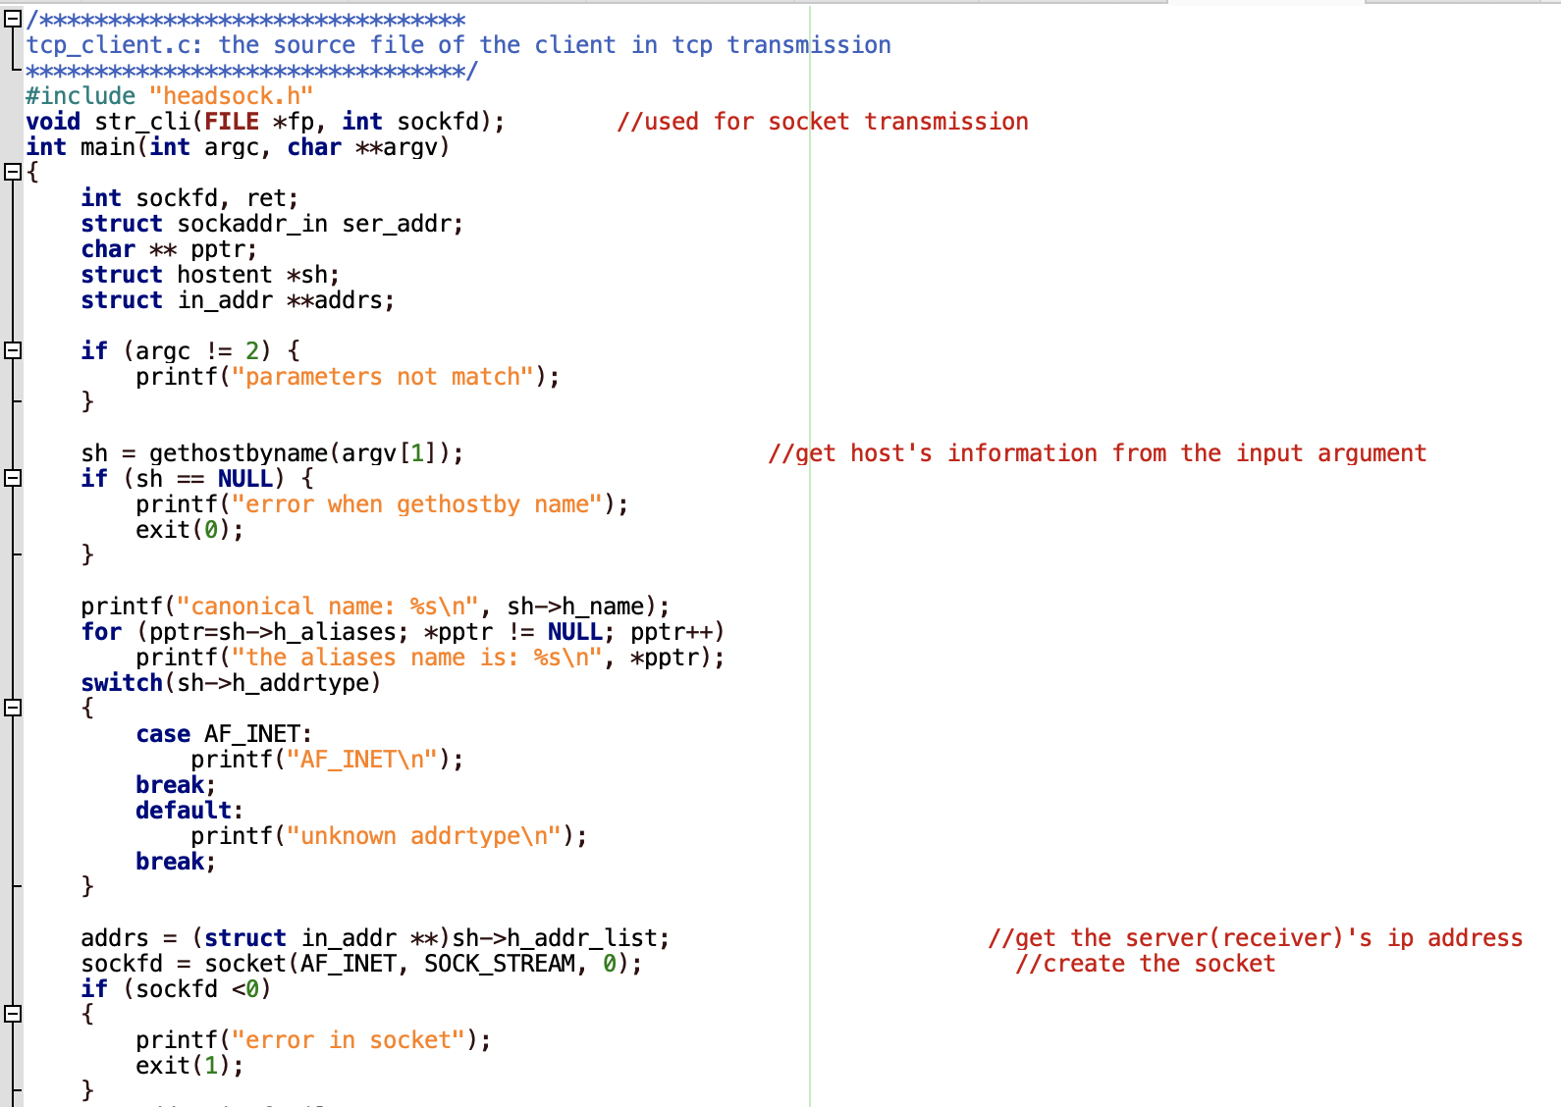

Slide 24
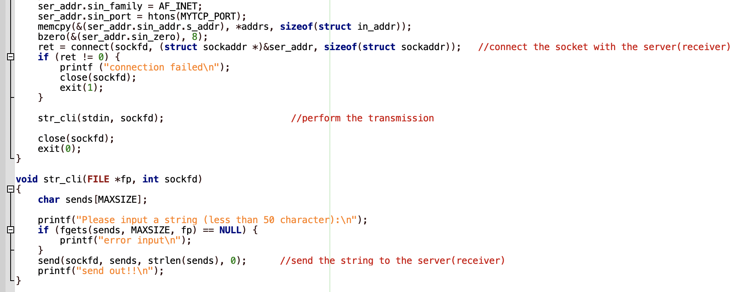

Slide 25
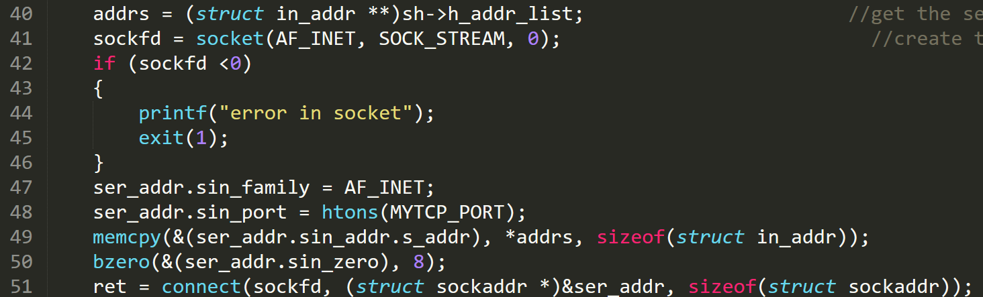
Example 1 (TCP): Client
Server address (from command line)
Creating a socket and connecting to it

Slide 26
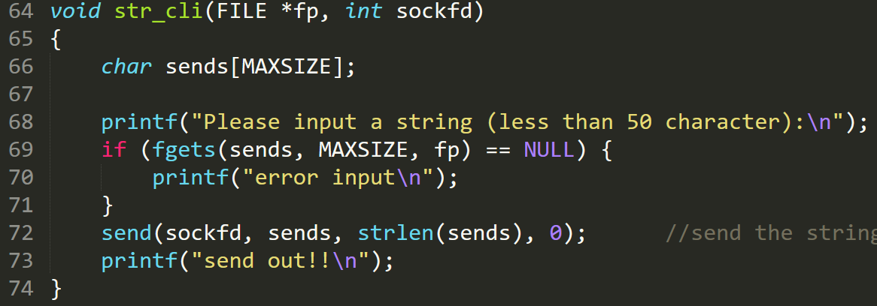
Example 1 (TCP): Client
Client application to send a string to the server

Slide 27
TCP
server
client
Create socket
Bind
Listen
Accept
Receive
Create socket
Connect
Send

Slide 28
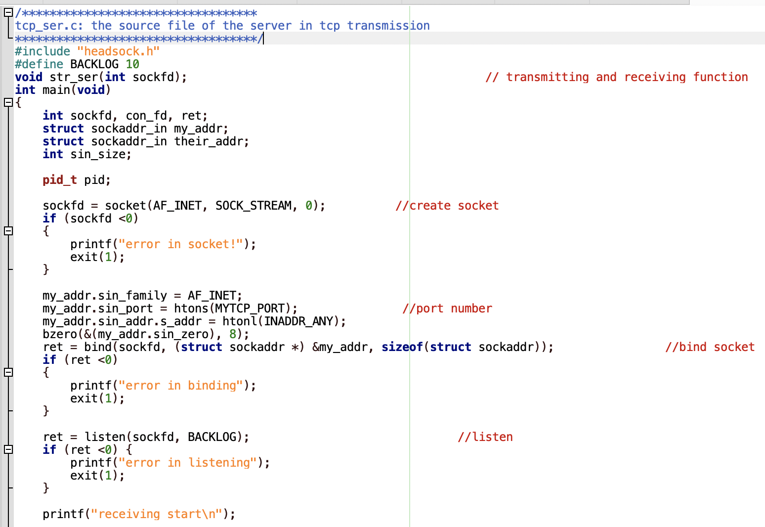

Slide 29
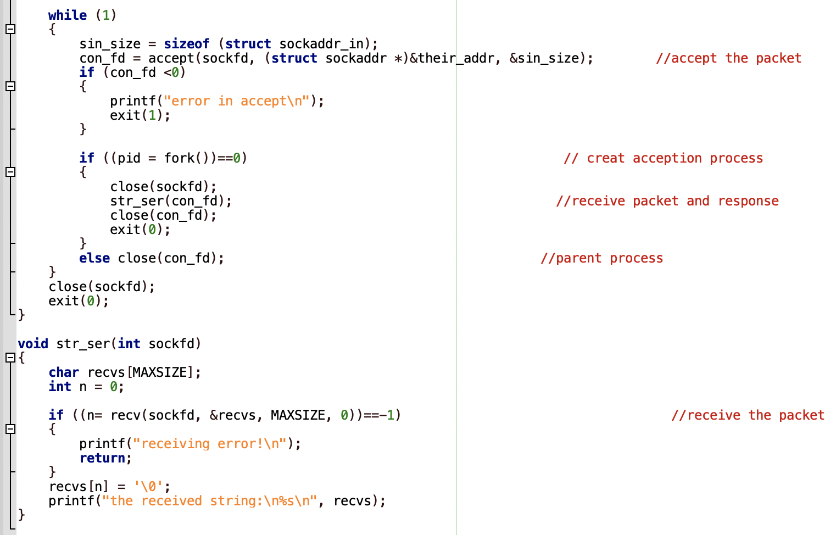

Slide 30
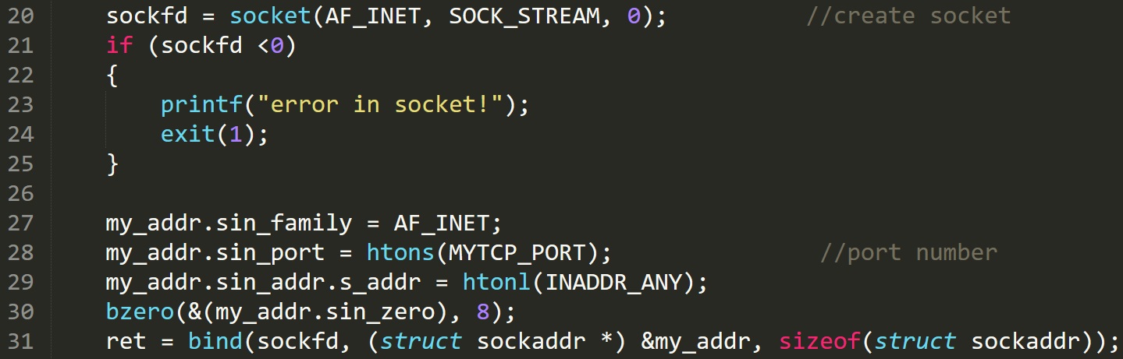
Example 1 (TCP): Server
Create a socket and bind at the server

Slide 31
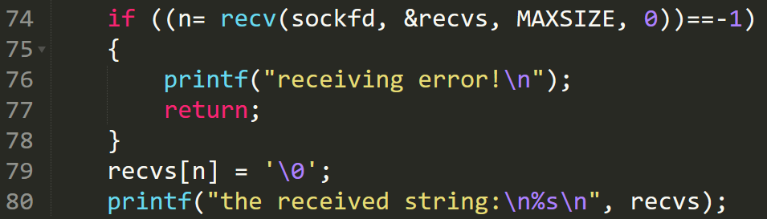
Example 1 (TCP): Server
Informs the OS, that socket is ready for requests (listen)
Connect to an incoming request (accept)
Server application to receive a string from a client

Slide 32
Lets try example 1
Server
client
Run the code
gcc tcp_ser1.c –o ser
Start Server
./ser
Run the code
gcc tcp_client1.c –o client
Start Server
./client 127.0.0.1
Note:
127.0.0.1 is a loopback IP.
To find IP address of any device, use command ‘ifconfig’

Slide 33
Example 2
Develop a TCP-based client-server socket program for transferring a large message. Here, the message transmitted from the client to server is read from a large file. The entire message is sent by the client as a single data-unit. After receiving the file, the server sends an ACK message to the receiver. Verify if the file has been sent completely and correctly by comparing the received file with the original file (“diff” command could be used). Measure the message transfer time and throughput.

Slide 34
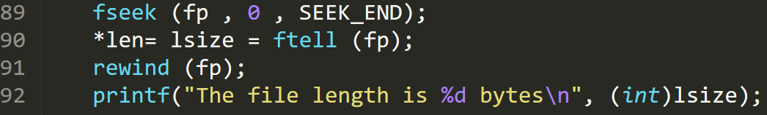
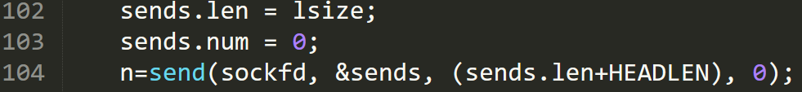
Example 2: Client
The TCP connection process is same as Example 1
Open the file in read mode
Determine the length of the file
Read the file into the buffer
Send the file to the server

Slide 35
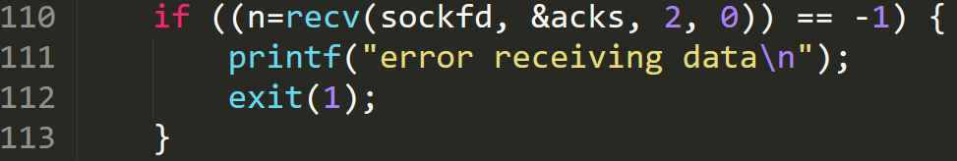
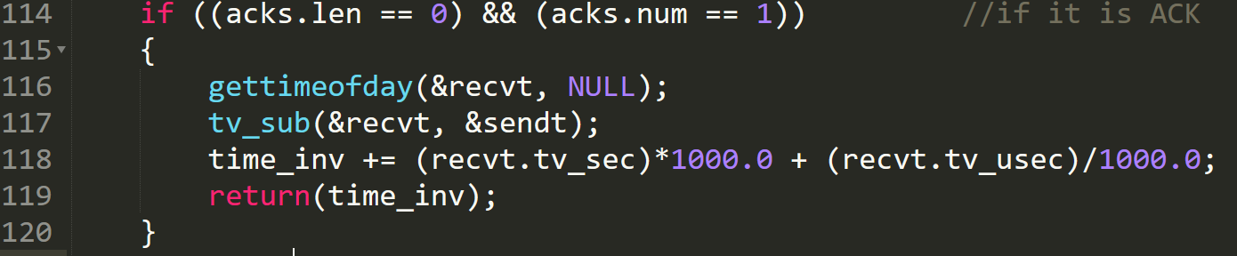
Example 2: Client
Wait for the ack
Check if it is an Ack and calculate the time taken

Slide 36
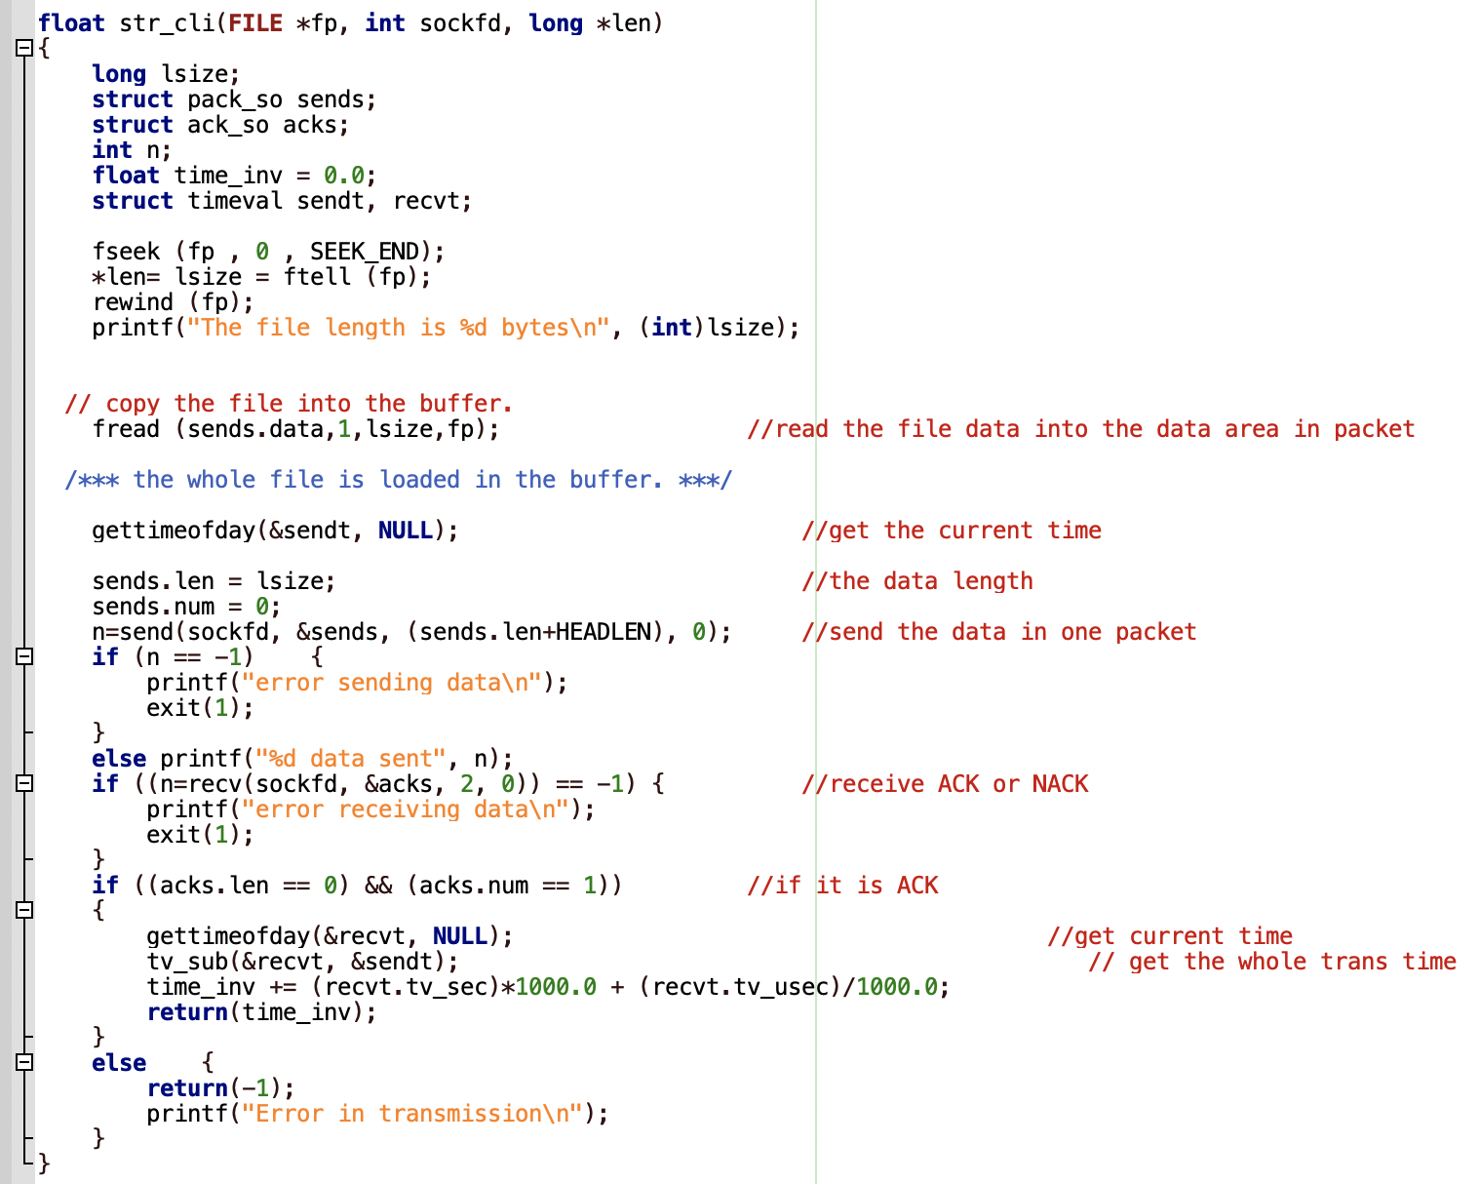

Slide 37
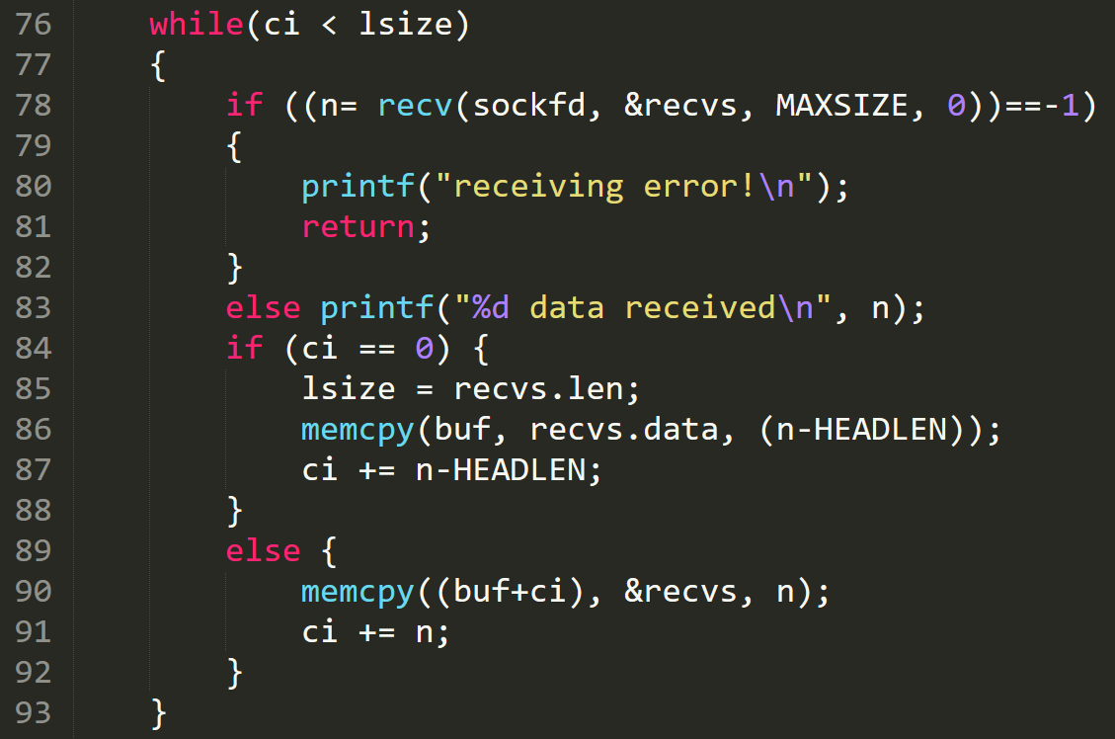
Example 2: Server
Receive the whole file from client

Slide 38
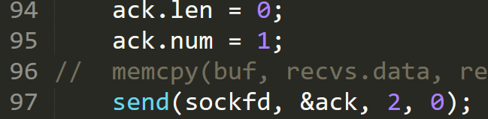
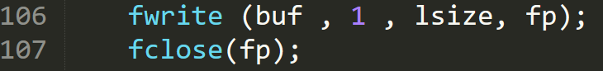
Example 2: Server
Send ack to client after receiving the whole file
Save the file from buffer to a file

Slide 39
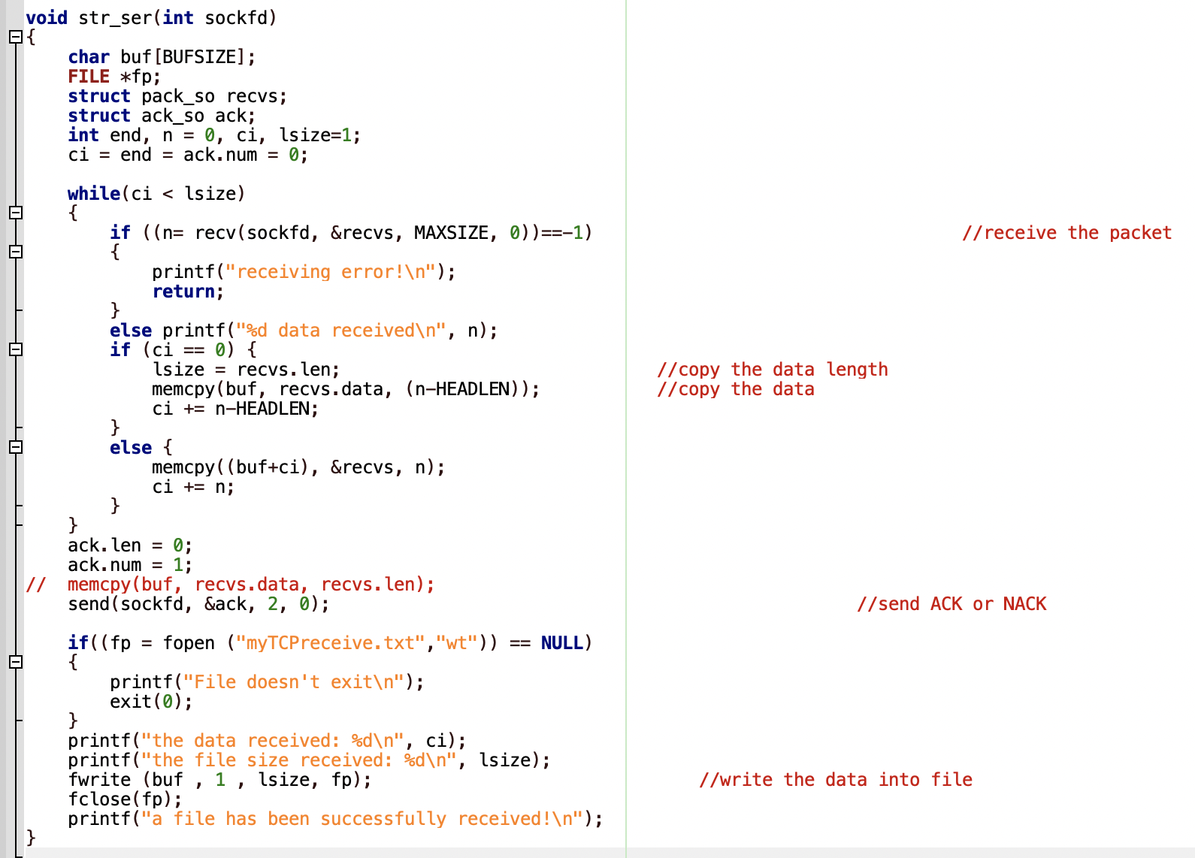

Slide 40
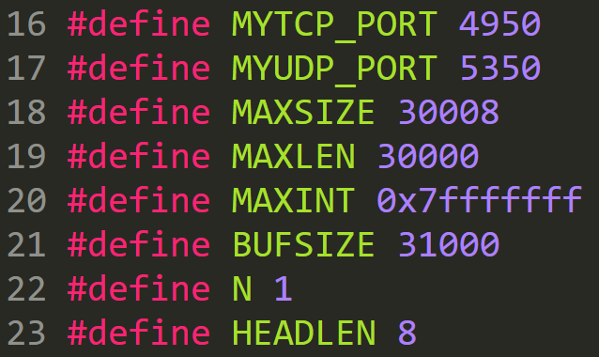
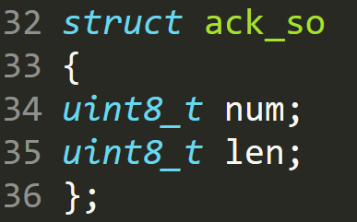
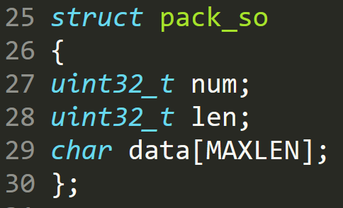
headsock.h (Ex 2)

Slide 41
Example 3
Develop a TCP-based client-server socket program for transferring a large message. Here, the message transmitted from the client to server is read from a large file. The message is split into short data-units which are sent one by one without waiting for any acknowledgement between transmissions of two successive data-units. Verify if the file has been sent completely and correctly by comparing the received file with the original file. Measure the message transfer time and throughput for various sizes of data-units.

Slide 42
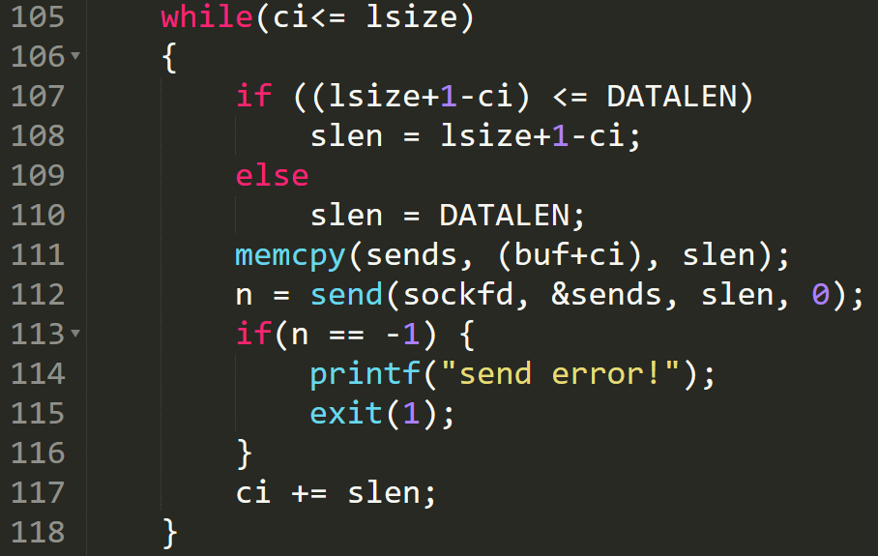
Example 3: Client sending file in data units
Sending file in data units of size DATALEN

Slide 43
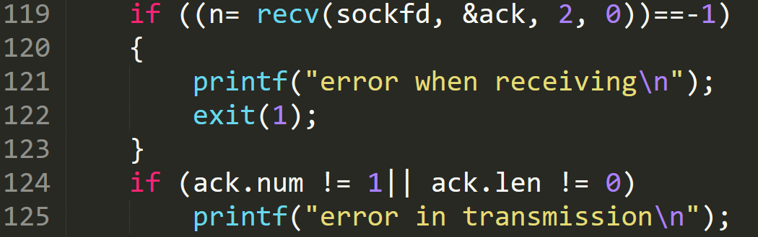
Client waits for Ack

Slide 44
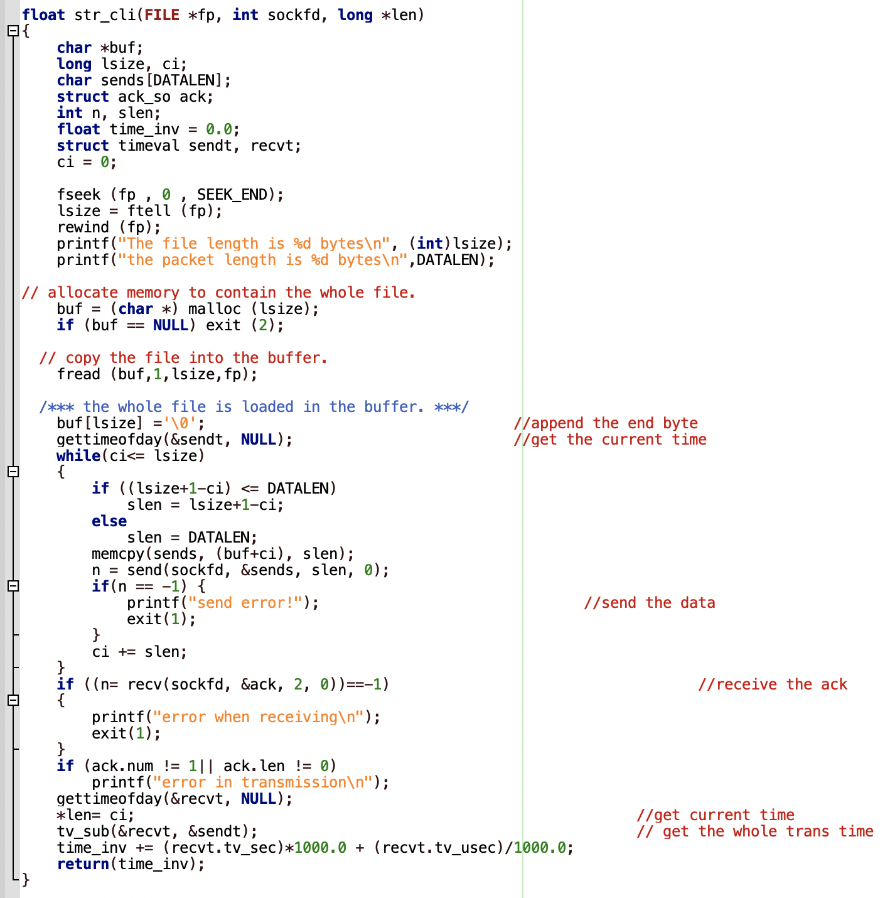

Slide 45
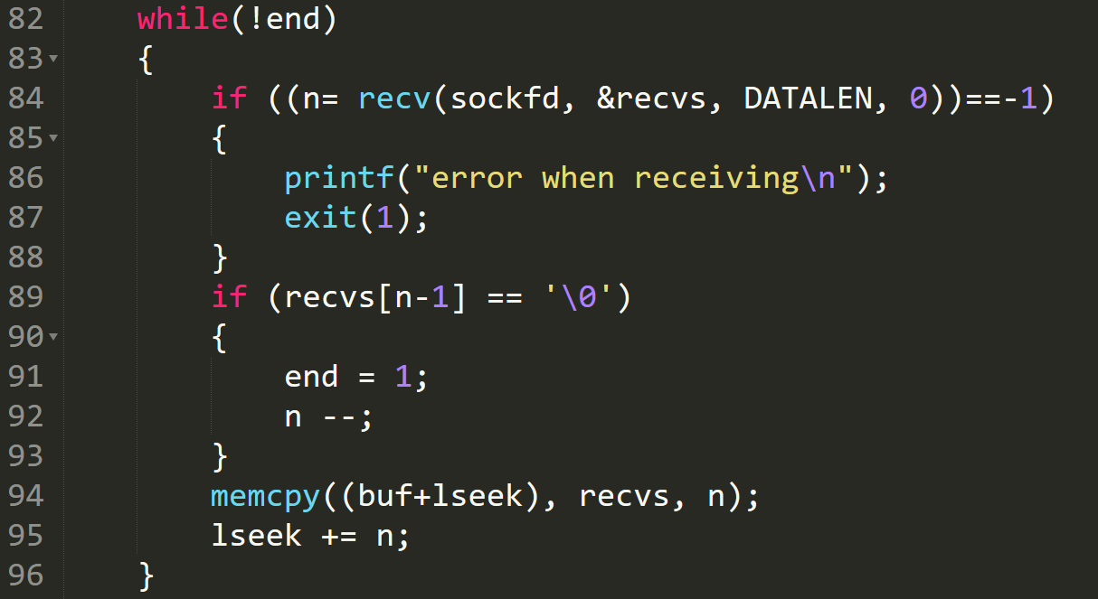
Example 3: Server receiving file in data units
Receiving file in data units of size DATALEN

Slide 46
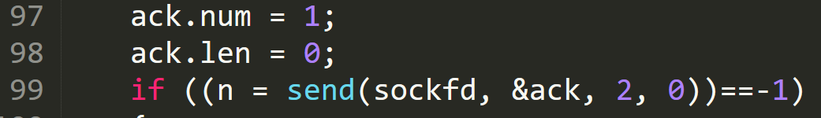
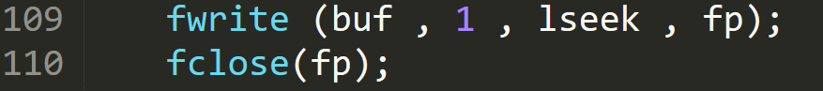
Server sending Ack and saving the file
Send ack to client
Save the file from buffer to a file

Slide 47
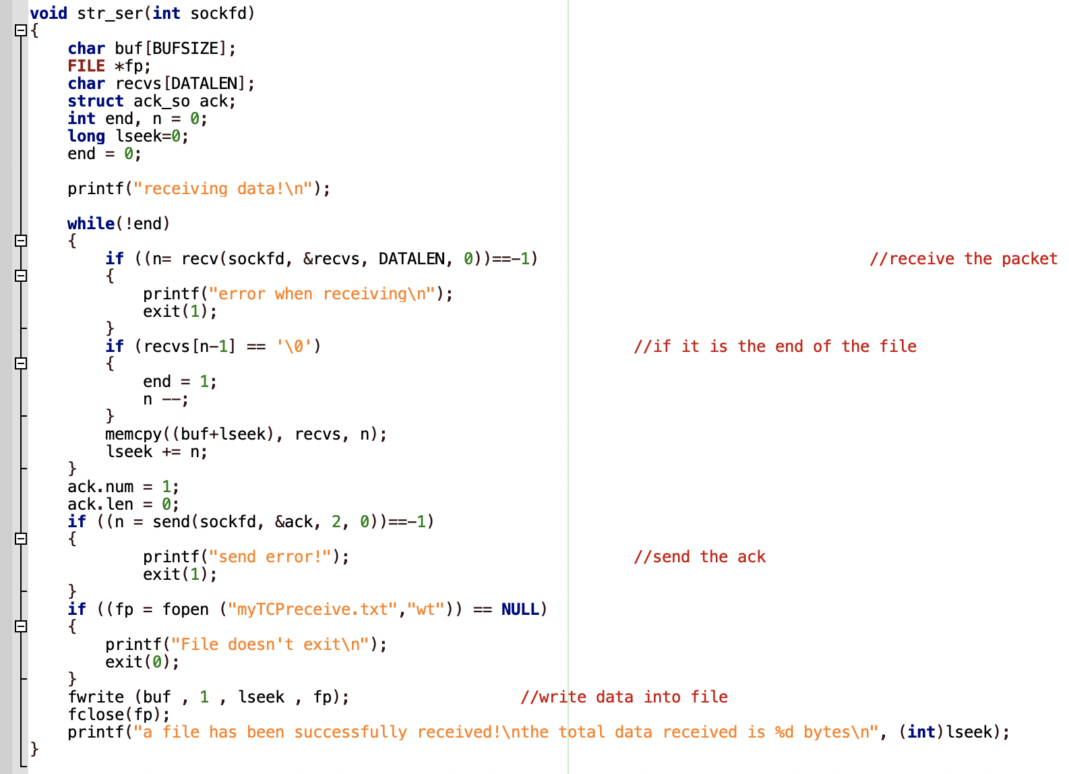

Slide 48
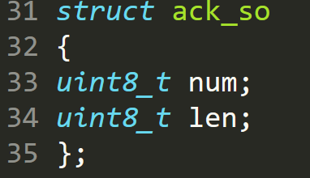
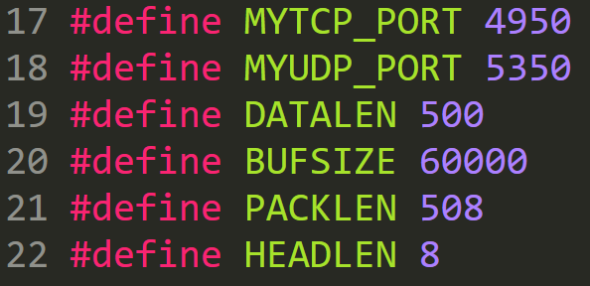
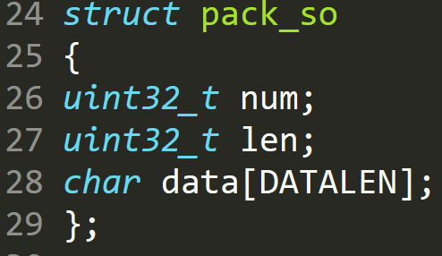
headsock.h (Ex 3)

Slide 49
Assignment Problem
Develop a UDP-based client-server socket program for transferring a large message. Here, the message transmitted from the client to server is read from a large file. The message is split into short data-units (DUs) which are sent and acknowledged in batches of size 1, 2, and 3 DUs. The sender sends one DU, waits for an acknowledgment (ACK); sends two DUs, waits for an ACK; sends three DUs, waits for an ACK; and repeats the above procedure until the entire file is sent. The receiver sends an ACK after receiving a DU; sends next ACK after receiving two DUs; sends next ACK after receiving three DUs; and repeats the above procedure.

Slide 50
Client
Server
1st transmission
1st reception
1
Wait for 1 packet then send ’ack’
2nd transmission
2nd reception
2
Wait for 2 packet then send ’ack’
3rd transmission
3rd reception
3
Wait for 3 packet then send ’ack’
And so on……
And so on……

Slide 51
Example 4 (Assignment Problem)
Verify if the file has been sent completely and correctly by comparing the received file with the original file. Measure the message transfer time and throughput for various sizes of data-units and compare it with the stop-and-wait protocol where the batch size is always fixed to be 1. Choose appropriate values for “data unit size” and measure the performance. Repeat the experiment several times and plot the average values in a report with a brief description of results, assumptions made, etc.
Include the following performance figures in your report:
Transfer time vs data unit size ( one curve for this problem and one curve for stop-and-wait )
Throughput vs data unit size ( one curve for this problem and one curve for stop-and-wait )

